Slide 1
CSE 3100: Systems Programming
Lecture 4: Functions and Global Variables
Department of Computer Science and Engineering
University of Connecticut

Slide 2
1. The Basics of Functions
2. Types of Variables in C
3. Memory Organization

Slide 3
1. The Basics of Functions

Slide 4
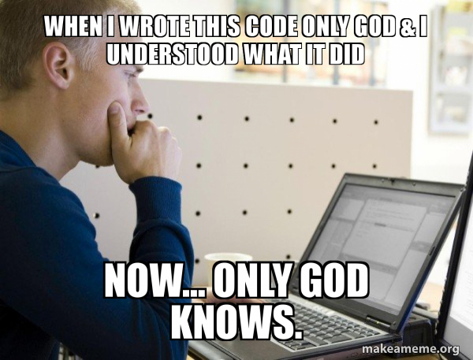
The Importance of Functions
Writing readable code in terms of functions is not some pie in the sky theoretical concept.
INDUSTRY: it WILL affect how easily other people can pick up and develop your code. It will affect how fast you can pick up old code and make progress.
RESEARCH: it WILL affect who uses your code base and who cites you.
When you write code without functions:

Slide 5
Functions: Building blocks for larger programs
Effective programming requires problem decomposition into manageable pieces.
A C program is made of functions
  Starting from main()
Idealized view: a function is a black box…
  It SPECIFIES what the computation will do
  It ABSTRACTS AWAY how the computational process works
  It takes INPUTS
  It produces an OUTPUT
Input1
Input2
Input3
Function
Output

Slide 6
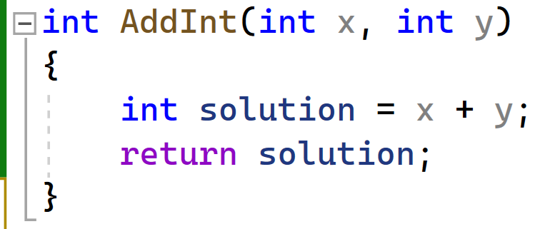
Writing a function in C

Slide 7
Writing a function in C
What type of variable the function returns
Variable type of the first input
Name of the function
Variable type of the second input

Slide 8
Writing a function in C: Return Statement
Body of the function to be executed.
Return indicates which variable should be passed out once the function ends.

Slide 9
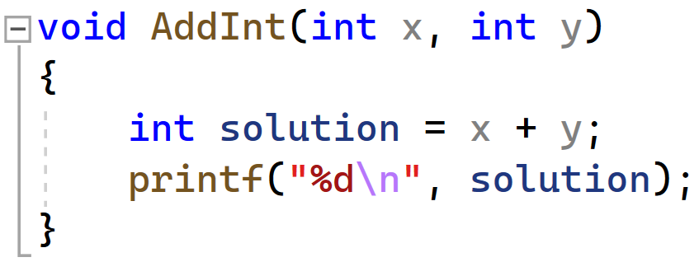
What happens if you don’t want the function to return anything?
Use the void keyword!

Slide 10
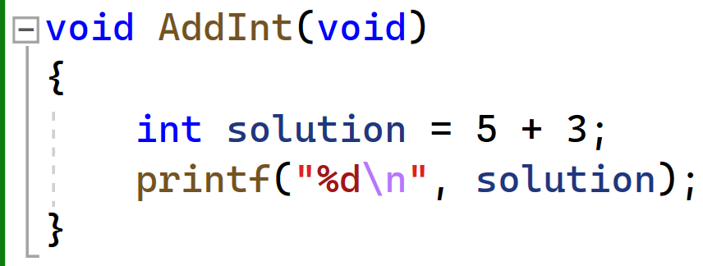
Side note: void can also be used if you don’t want to pass anything into the function

Slide 11
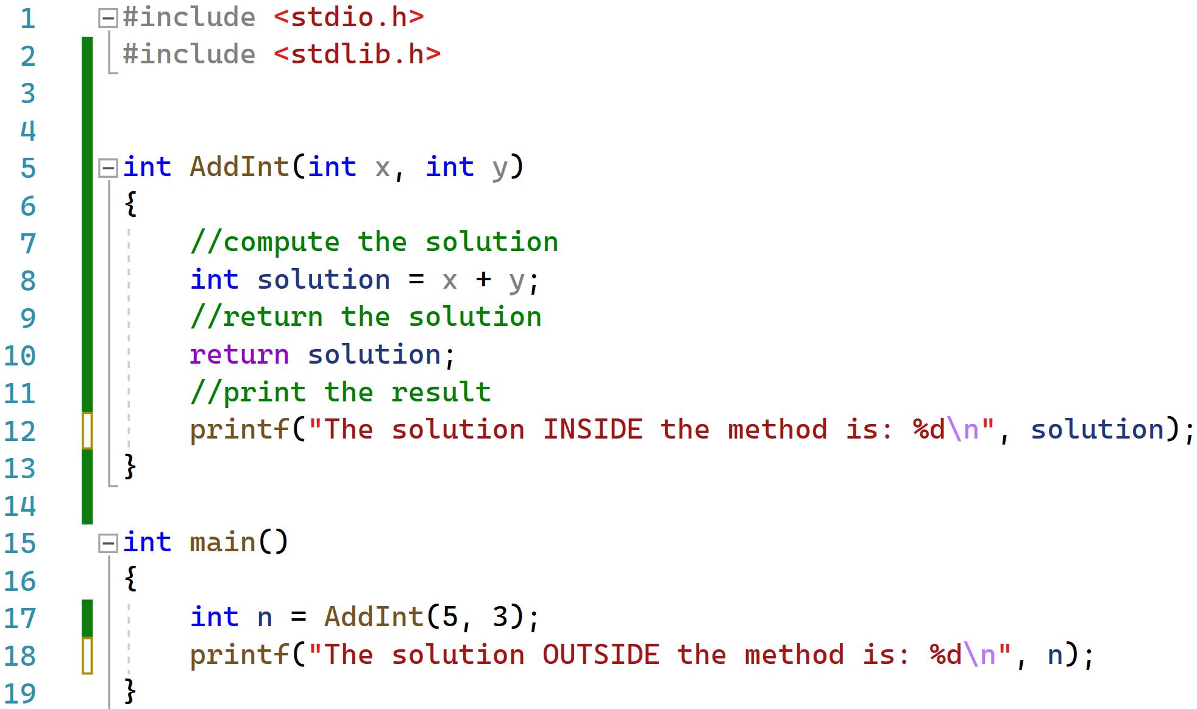
Understanding the return statement
Given the following code: what will print out?

Slide 12
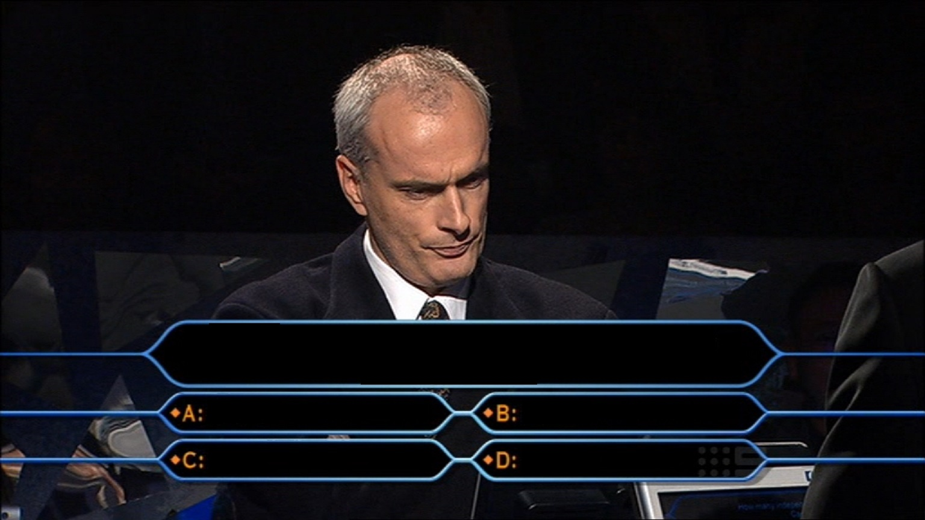
What will print out from the following code?
Nothing
1 print statements
2 print statements
Not sure. I am illiterate.

Slide 13
Understanding the return statement
Only the print statement highlighted in red will print. Why?
Once the return statement runs, the rest of the body of the function will NOT execute. We return to main.

Slide 14
Function Prototypes
Functions can be defined in any order
  Declare a function before first use if definition comes later
  Function prototypes often placed in header files (and reused)
#include <stdio.h>
int fahrToCelsius(int);
int main() {
for(int fahr=0; fahr <= 300; fahr += 10)
printf("%d F is %d C degrees\n",fahr,fahrToCelsius(fahr));
return 0;
}
int fahrToCelsius(int degF) {
return 5 * (degF - 32) / 9;
}
Declaration/Prototype of the function
Definition of the function

Slide 15

What is the purpose of function prototypes?
Compiler checking the prototype:
C Programmer:
A function prototype tells the compiler the number and type of arguments that are to be passed to the function and the type of the value that is to be returned by the function.
Function prototypes allow the compiler to check the code more thoroughly.

Slide 16
Side Note 1: Macros in C
You can actually put the entire function in a single line if you so desire:
#define MIN(x,y) ((x) < (y) ? (x) : (y))
#define MAX(x,y) ((x) >= (y) ? (x) : (y))
int main()
{
int a = 10, b = 20;
int x = MIN(a,b);
}

Slide 17
Side Note 2: Recursion in C
C does support recursive programming…
Non recursive way to write power function:
Recursive way to write power function:
int power(int base,int n) {
int rv = 1;
while (n>0) {
rv *= base;
n--;
}
return rv;
}
int power(int base,int n) {
if (n==0)
return 1;
else {
int p = power(base,n-1);
return base * p;
}
}

Slide 18
Summary of the Basic Function Examples
type function_name ( parameter_list ) {
declarations & statements
}
No nesting (cannot define functions in a function)
Return type can be “void” (no return value expected)
  If missing, compiler assumes int
Return statements:
Execution also terminates if end of function body reached
  Returned value undefined
return; // terminate execution and return control to caller
return expr; // terminate and pass value of expr back to caller

Slide 19
2. Types of Variables in C

Slide 20
Types of Variables in C (based on scope)
Local variables
Static local variables
Global variables
Static global variables

Slide 21

Types of Variables in C: Local Variables
Trying to figure out the local variable value after leaving the function:
Local variables
  Only visible inside the function.
  Value is not retained across function calls.

Slide 22
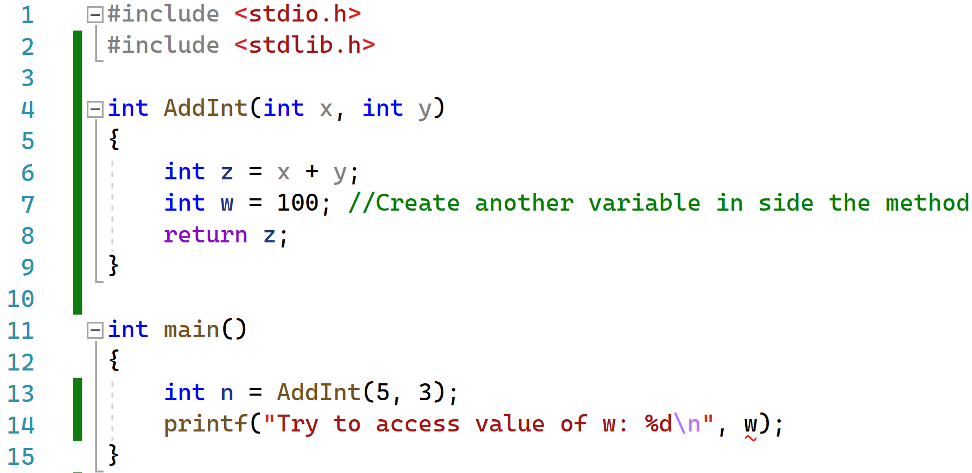
Local Variable Code Example
Local variables: only accessible in the method where they are created.
What happens if we try to print the value of w in the main?

Slide 23
Types of Variables in C: Static Local Variables
2. Static local variables
  Not visible outside function, but retain value across function calls.

Slide 24
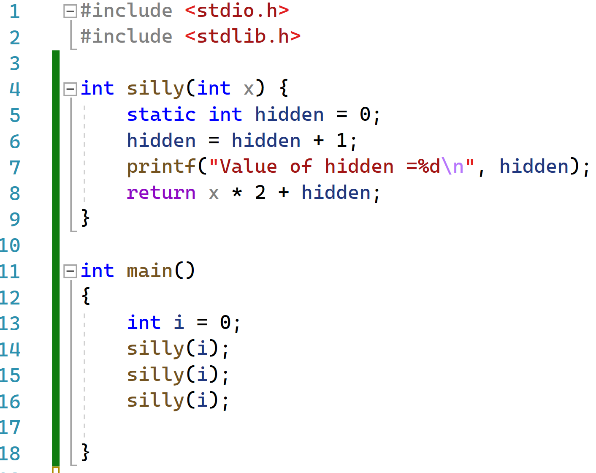
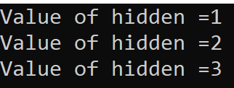
Local Static Variable Code Example 1
What is the value of hidden after the code finishes?

Slide 25
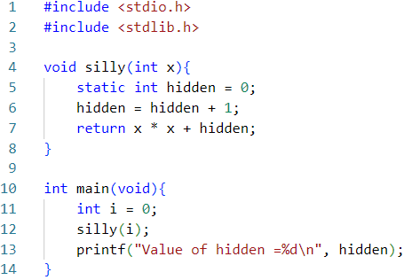
Local Static Variable Code Example 2
What will be the output of this code?
Won’t compile!
Local static functions can’t be accessed outside of the function they are created in.

Slide 26
Types of Variables in C: Global Variables
3. Global variables
  Declared outside functions.
  Variable retained for entire duration of program.

Slide 27
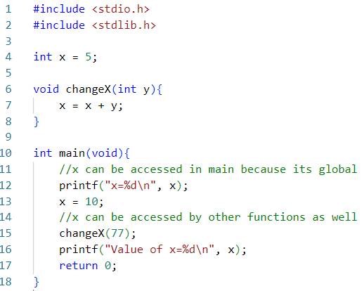
Global Variable Code Example
Declare global variable here.
Global variables can be accessed in main without being passed as a parameter.
Global variables can be accessed by other methods without being passed as a parameter.

Slide 28
Types of Variables in C: Global Variables
4. Global static variables
  Declared outside functions.
  Variable retained for entire duration of program.
  Visible only in functions defined in the same file following variable declaration.

Slide 29
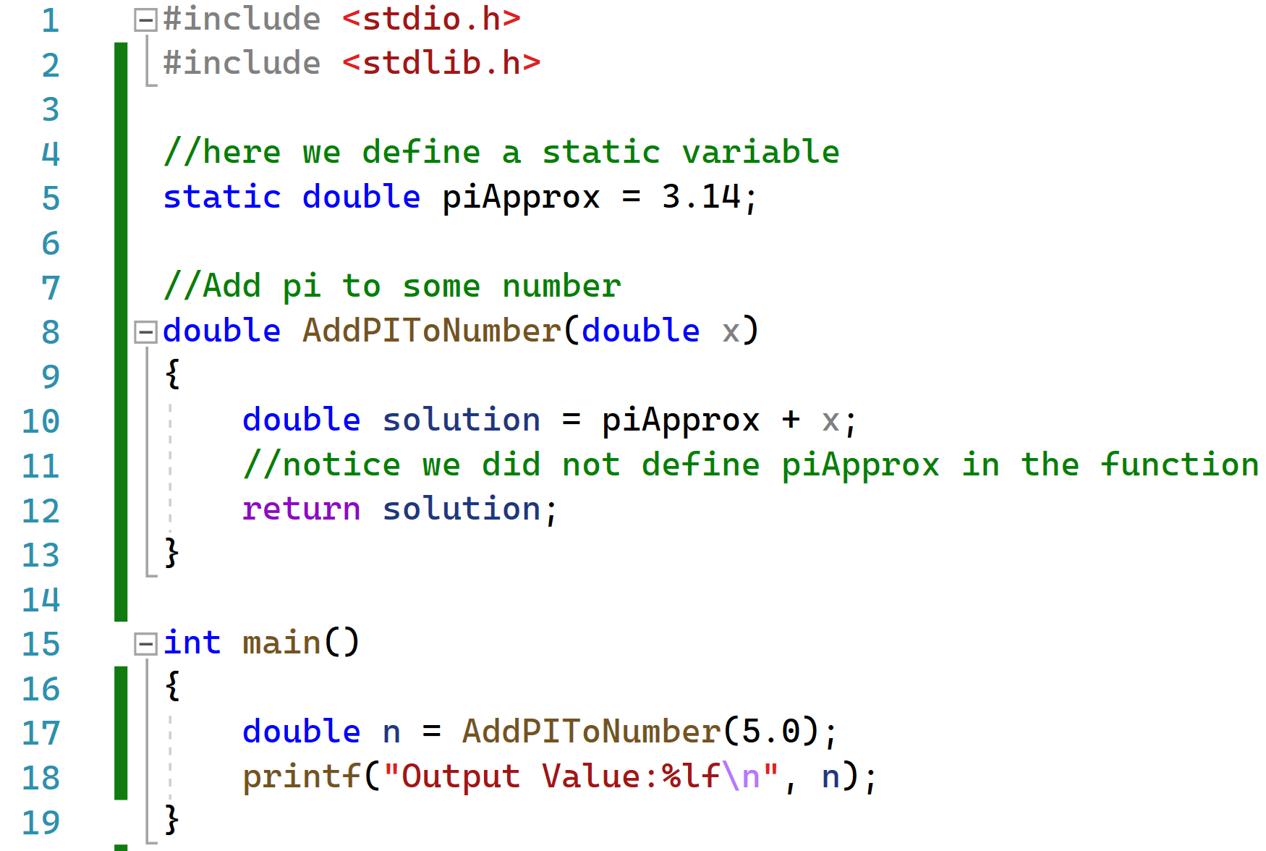

Global Static Variable Code Example

Slide 30
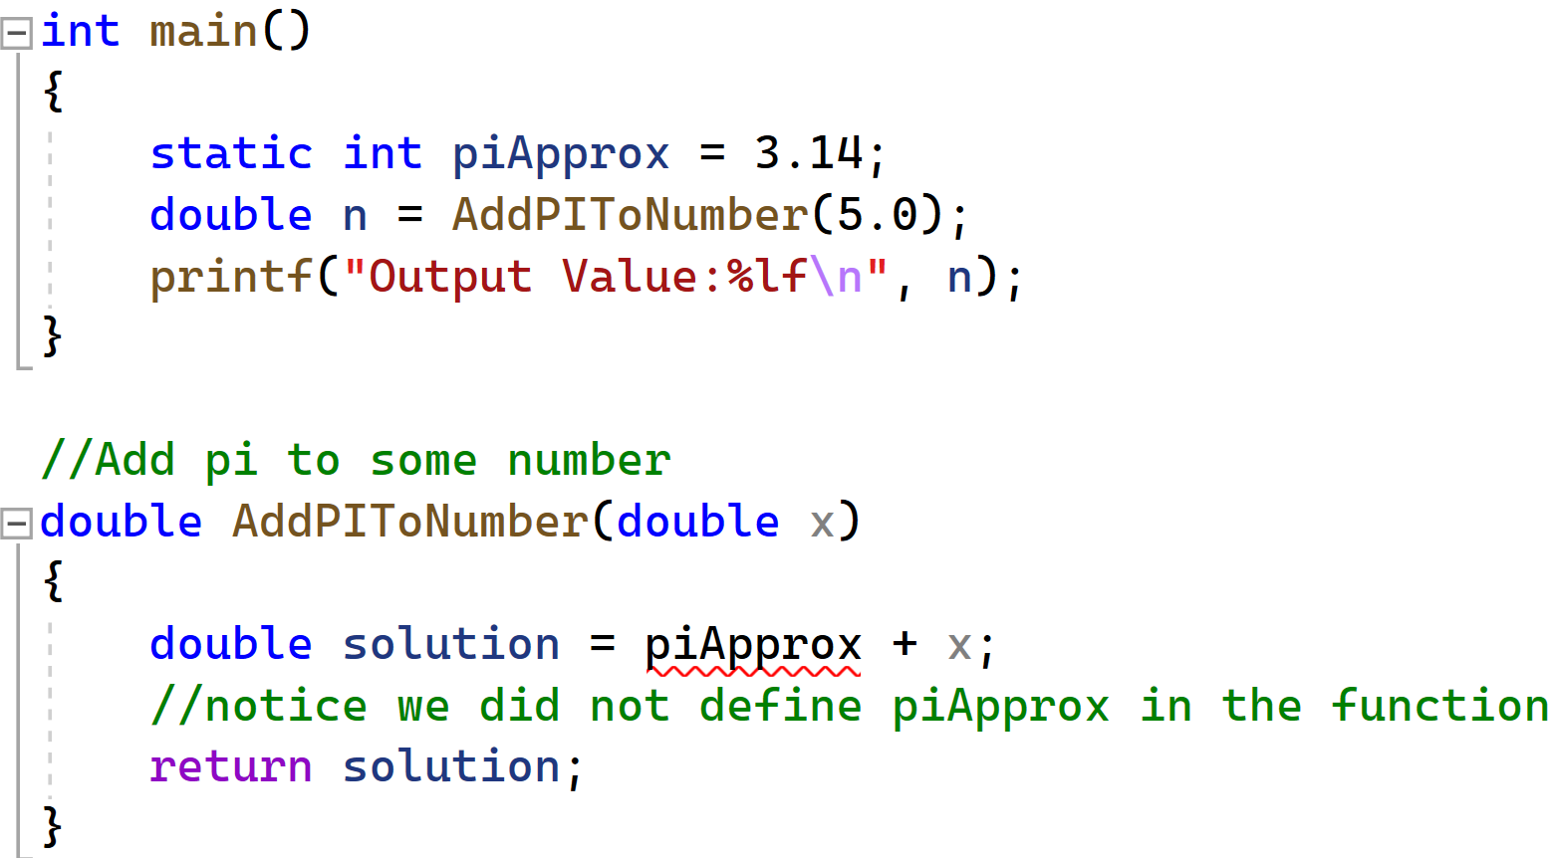
Test your knowledge: Is piApprox a global or local static variable here? Would this code run?

Slide 31
Summary of the types of variables
Entire Code (multiple .c files)
Global Variables
(all .c files in your code can access)
SomeFile.c
Global Static Variables
(only methods in SomeFile.c can use)
void SomeMethod()
Local Static Variables
Local Variables
(only SomeMethod can use)

Slide 32
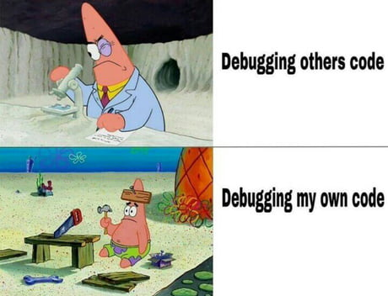
Be cautious with static and global variables
Declares all variables globally:
“Nice” functions only depend on their inputs
Static and global variables have side-effects
  Retain values across function calls
  Change the meaning of the function at each call!
  You cannot understand the function without holding all the code in your head.
30 seconds later when errors occur:

Slide 33
Function Call Context
Function call context includes
  Copies of function arguments (call-by-value)
  (Auto) local variables
  Return address, …
Call contexts managed automatically using the execution stack
  A stack frame is created automatically for each function call
  The frame lasts for the duration of the call
  Discarded automatically when the function terminates
  NOTHING in the frame survives the call

Slide 34
3. Memory Organization

Slide 35
Memory Organization
Memory….
  Every Process has an
    Address Space
0xffffffff
High
Low
0x00000000

Slide 36
Memory Organization
0xffffffff
Memory….
  Every Process has an
    Address Space
  Executable code is at the bottom
    Not exactly from address 0
High
Low
0x00000000

Slide 37
Memory Organization
Memory….
  Every Process has an
    Address Space
  Executable code is at the bottom
  Statics and globals are just above
0xffffffff
High
Low
0x00000000

Slide 38
Memory Organization
Memory….
  Every Process has an
    Address Space
  Executable code is at the bottom
  Statics and globals are just above
  Stack is at the top (going down!)
0xffffffff
High
Low
0x00000000

Slide 39
Memory Organization
Memory….
  Every Process has an
    Address Space
  Executable code is at the bottom
  Statics and globals are just above
  Stack is at the top (going down!)
  Heap grows from the bottom (going up!)
0xffffffff
High
Low
0x00000000

Slide 40
Memory Organization
Memory….
  Every Process has an
    Address Space
  Executable code is at the bottom
  Statics and globals are just above
  Stack is at the top (going down!)
  Heap grows from the bottom (going up!)
  Gray no-man’s land is up for grab
  Low end may not start from 0.
  High end may not be the 0xff…ff.
0xffffffff
High
Low
0x00000000

Slide 41
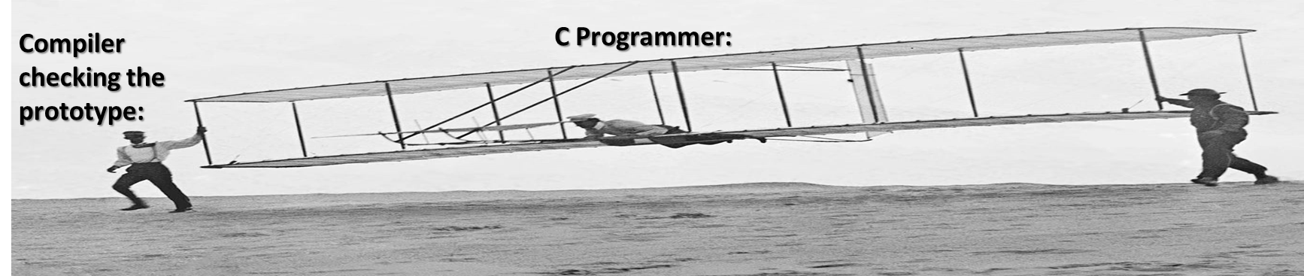

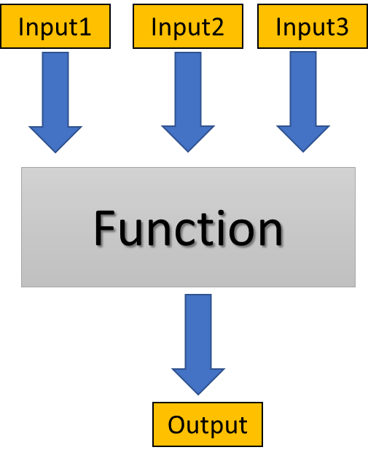
Function Lecture Conclusions
Code should be split into different functions for readability and ease of use.
C has global and local variables, as well as the static keyword.
Use of global variables may be necessary from a design point of view, but should be used sparingly.

Slide 42
Figure Sources
https://i.pinimg.com/originals/2a/74/33/2a7433d23ce752166b7abc910299ff15.jpg
https://pbs.twimg.com/profile_images/3092028479/15db929f6739606a1aefc74277951af8_400x400.jpeg
https://media.makeameme.org/created/when-i-wrote-a49411.jpg
https://i.imgflip.com/17t6zh.jpg
https://img-9gag-fun.9cache.com/photo/am5j20j_460s.jpg
https://media.tenor.com/BiUtqfsTcqcAAAAC/memory-no-memory.gif

